Slide 1

Telco Customer Churn
Lara Miller
March 23, 2022

Slide 2
What is Telco?
Fictitious telecommunications company offers phone and internet services
Why predict churn?
Costs company 5x more to attain NEW customer than to keep an existing one
Project Goals
Create classification model to predict customer churn
Use model to identify areas within Telco business that could be improved to help retain customers

Slide 3
Data
7024 Customers | 25 features
Product and Services
Geographic
City
Zip code
Latitude
Longitude
Demographics
Senior
Dependents
Gender
Churn
Churn (yes, no)
Churn reason
Customer lifetime value
Phone Service
Multiple Lines
Internet Service
Online Security
Online Backup
Device Protection
Tech Support
Streaming TV
Streaming Movies
Contract
Paperless Billing
Payment Method
Monthly Charges
Total Charges
Tenure (months)
Partner

Slide 4
Process for creating a classification model
Exploratory Data Analysis & Feature Engineering
Model Fitting & Tuning
Model Selection
Feature Importance

Slide 5
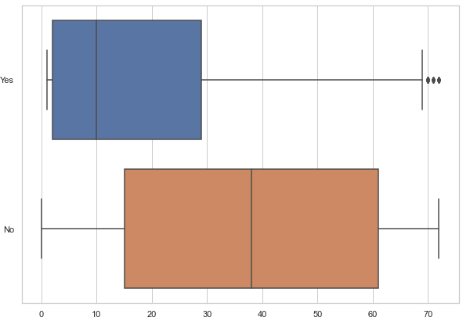
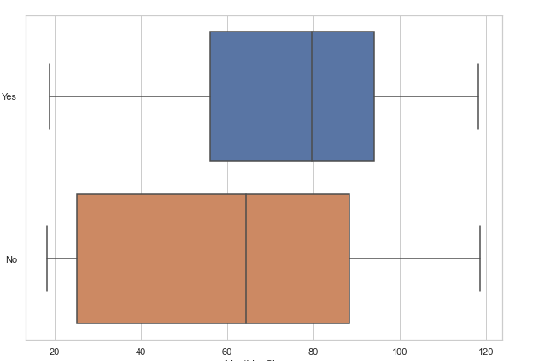
Baseline
Exploratory Data Analysis & Feature Engineering
Model Fitting & Tuning
Model Selection
Feature Importance
Tenure for churned customers lower than for customers who stay
Monthly charges for churned customers much higher than for customers who stay
Churned customer
Non-churned customer

Slide 6
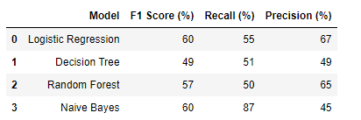
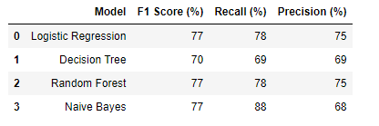
Baseline
No model tuning
Exploratory Data Analysis & Feature Engineering
Model Fitting & Tuning
Model Selection
Feature Importance
Correct imbalance and cross validation
60% to 77%

Slide 7
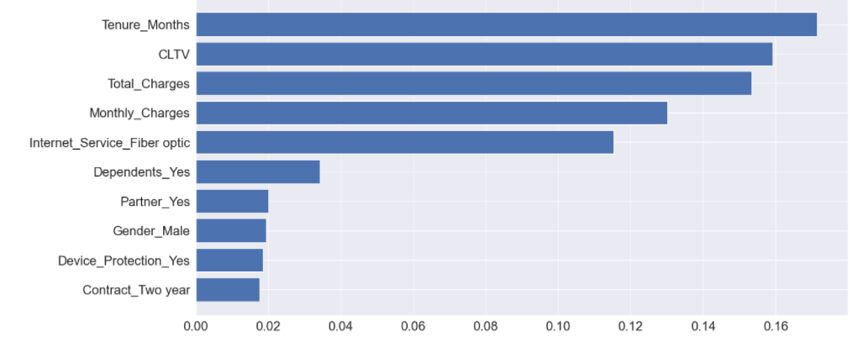
Baseline
Top 5 features
Tenure (months)
Customer lifetime value
Total Charges
Monthly charges
Fiber optic internet service
Exploratory Data Analysis & Feature Engineering
Model Fitting & Tuning
Model Selection
Feature Importance

Slide 8
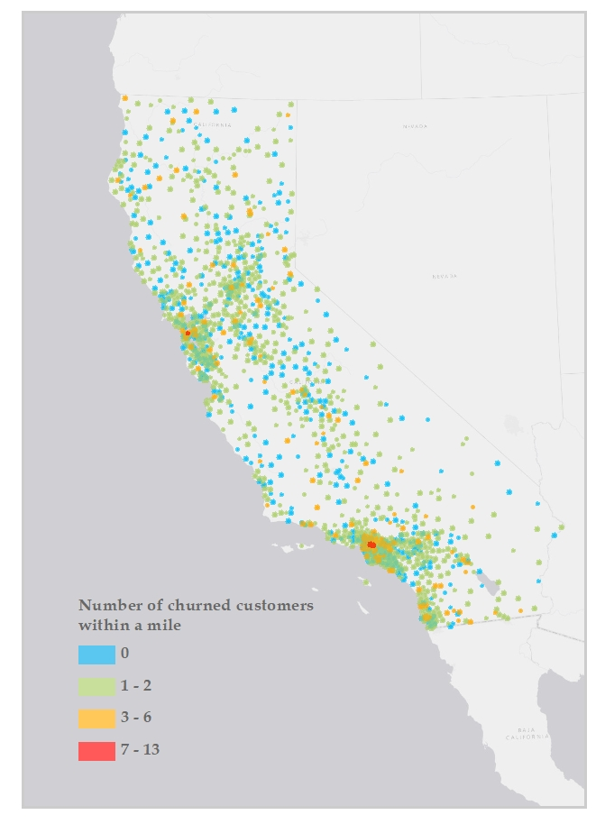
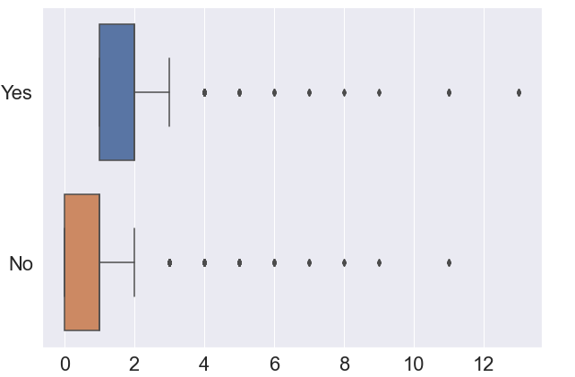
Final iteration
1. Remove correlated features
2. Engineer geographic customer information
Exploratory Data Analysis & Feature Engineering
Model Fitting & Tuning
Model Selection
Feature Importance
Hotspots of churned customers
churned
Churned
Not churned
# churned customers
within a mile

Slide 9
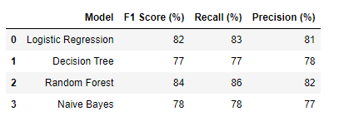
Final Iteration
No model tuning
Exploratory Data Analysis & Feature Engineering
Model Fitting & Tuning
Model Selection
Feature Importance
Correct imbalance and cross validation
With geographic feature and Total Charges removed
60% to 84%

Slide 10
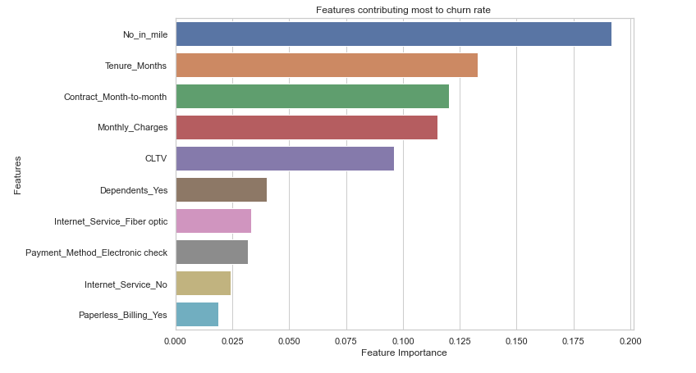
Final iteration
Top 5 features
Number churned customers within mile
Tenure (months)
Contract (month to month)
Monthly charges
Customer lifetime value
Exploratory Data Analysis & Feature Engineering
Model Fitting & Tuning
Model Selection
Feature Importance

Slide 11
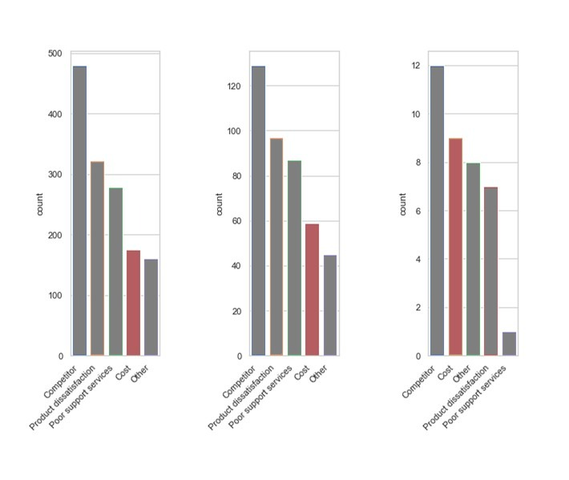
Telco business recommendations
1 to 2 churned
w/in a mile
3 to 4 churned
w/in a mile
> 5 churned
w/in a mile
Cost of products and services is more commonly given as a reason for leaving in churn hotspots
Look at minimizing installation and servicing of fiber optic and therefore increase the return on investment that can be past onto the customer.

Slide 12
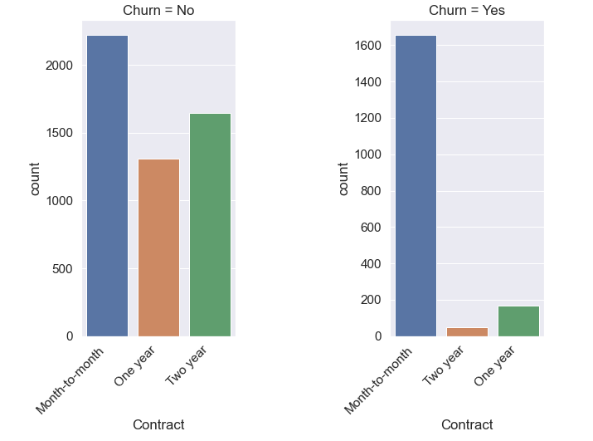
Telco business recommendations
Most churned customers have month-to-month contracts
Offer incentive packages for signing an annual or two-year contract
Top 5 features
Number churned customers within mile
Tenure (months)
Contract (month to month)
Monthly charges
Customer lifetime value

Slide 13
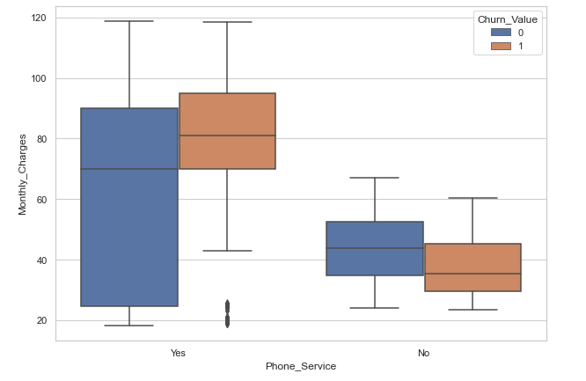
Telco business recommendations
Monthly charges are higher for churn customers with phone services
Get additional data for these customers to assess why they are paying more for standard services.
Do they have high overage charges?
Are they in areas with high taxes and fees)

Slide 14
Thank You

Slide 15
Appendix

Slide 16
Tools
Python Libraries
Pandas
numpy
Scikit-learn
GIS
- ArcGIS (buffer, spatial join)

